Slide 1

Quick ‘N Speedy Delivery
TEAM MEMBERS:​
S.J SUMANTH (2010030377)​
K. SREEVARUN (2010030451)​
E. PAVAN SAI (2010030538)​
E. SHIVA GOUD (2010030542)​
Under the guidance of
DEEPTHI KALAVALA

Slide 2

Outline
Introduction and problem statement
Present/Naive method
Proposed Solution
DataStructures
GITHUB setup
Work division

Slide 3
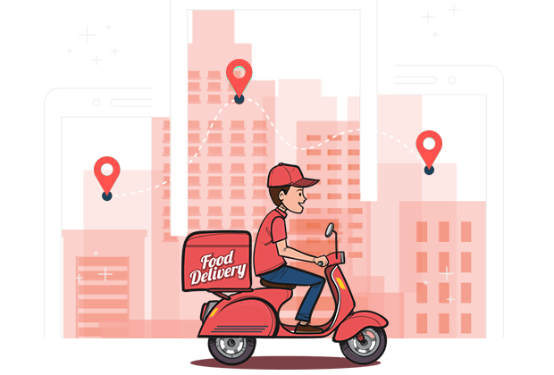
Introduction &PROBLEM STATEMENT
We have many food delivery apps like Swiggy, Zomato, Eat Sure etc.
Daily thousands of orders are made through these apps. In most cases, a driver should take more than one order at a time and deliver the same to respective customers in the given time.
So, in order to deliver all orders at the given time the delivery executive should choose the optimal path from source to destination.
He should delivery in time with minimum distance so he can save his time and get profit .
Here the condition is he should visit all the ordered cities and return to the start point.

Slide 4
Existing way of delivery:
Presently the order delivery system ,they deliver randomly to a location without comparing the distances.
This makes them into loss of profit and time waste.
If they got four orders, they pick the order and they go randomly to deliver it one by one. Here if they go random without checking distances, they miss the shortest path to the same destination.
In which it save them much time and profit in transportation.
So , in this way the present ordering system in going on .
In which we can have a solution for this issue with the help of our proposed method.

Slide 5
GREEDY APPROACH:
So, for this problem we came up with a solution called greedy method.
In this method first of all he should note all the delivery distances from his point.
Now, he should choose the less distance delivery address and go to delivery first there.
Next ,from that city/address he should note the other distances for given delivery address and choose the least one and go to that address next.
In this way he have to make a list and select the least distance delivery from the list and at last he will return to the same point where he started.
Proposed Solution

Slide 6
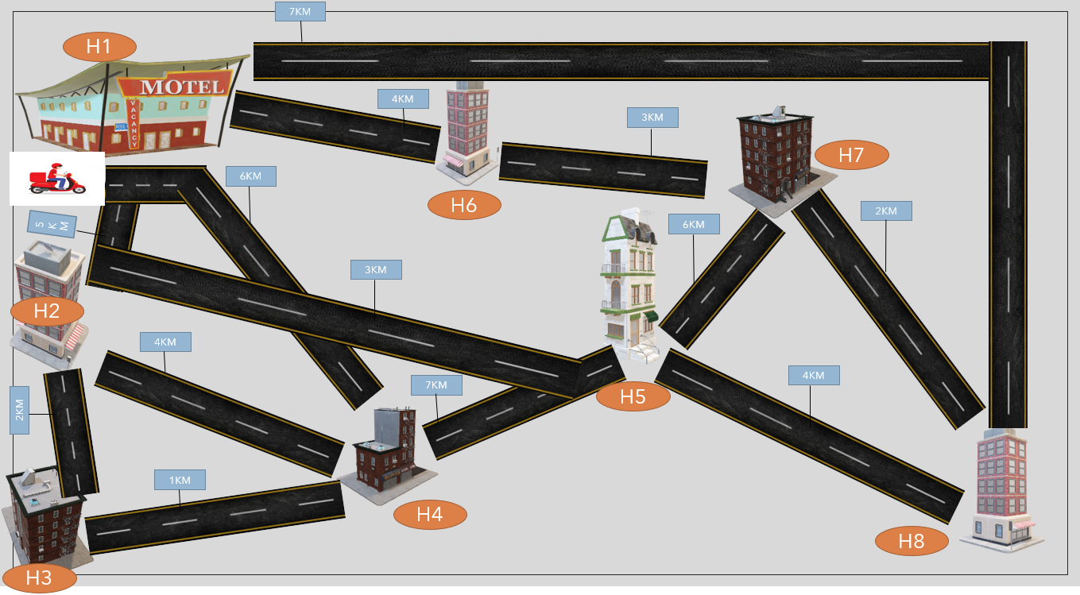

Slide 7
 | H1 | H2 | H3 | H4 | H5 | H6 | H7 | H8
H1 | 0 | 5 | --- | 6 | -- | 4 | -- | 7
H2 | 5 | 0 | 2 | 4 | 3 | --- | -- | --
H3 | -- | 2 | 0 | 1 | -- | -- | --- | --
H4 | 6 | 4 | 1 | 0 | 7 | -- | -- | --
H5 | --- | 3 | -- | 7 | 0 | -- | 6 | 4
H6 | 4 | -- | -- | -- | -- | -- | 3 | --
H7 | -- | -- | -- | -- | 6 | 3 | 0 | 2
H8 | 7 | -- | --- | -- | 4 | -- | 2 | 0

Slide 8

DATA STRUCTURES

Slide 9
Using array data structure Representation
splay trees Representation
Segment Tree Representation
Two-Level Tree Representation

Slide 10
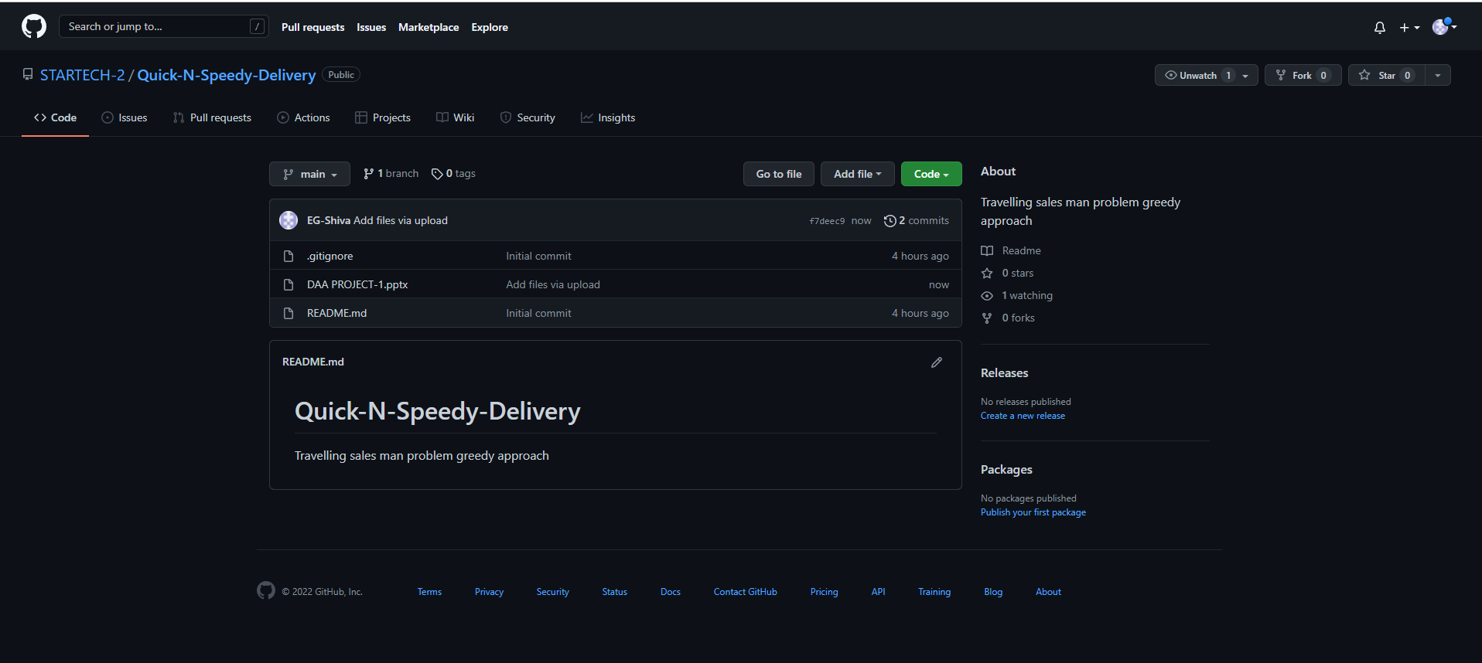
GITHUB setup
https://github.com/STARTECH-2/Quick-N-Speedy-Delivery.git

Slide 11
Work division
SUMANTH(377)→PPT , Information collection
SREEVARUN(451)→Information collection,ppt(design)
PAVAN SAI(538)→Information collection,ppt(title)
SHIVA GOUD(542)→Information collection ,GITHUB SETUP,ppt(example)

